Slide 1
Getting started with git and github
April 29th, 2024

Slide 2
Objectives
Learn basics of version control with git
Cycle of work
Terminology
Commands
Learn basics of github
Remote repositories
Setting up keys
Sharing code
Level up
Collaborating with forks and pull requests
Github pages – portfolio for your code
Conflicts and merging
Starting over (if all else fails)

Slide 3




Terminology: remote versus local repository
Github.com hosts git repositories
https://github.com/your-username/your-repo-name
You clone the remote repo to your computer

Slide 4

Steps to working on a repo: step 0. Clone repo.
Clone Remote (1st step, done once)
New project → Clone existing repo
Downloads files
and git data
Downloads files
and git data
Creates new folder on your computer. Working tree (your files)
Creates new folder on your computer. Repository files are in “File ”tab in RStudio

Slide 5
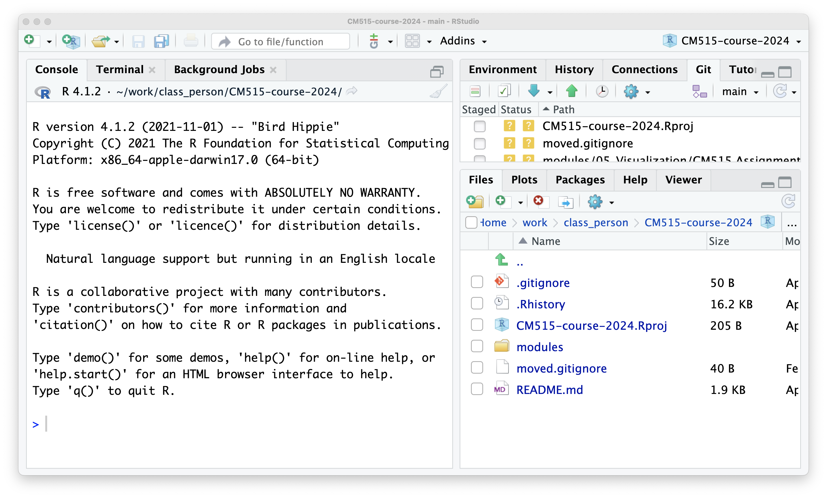
untracked file
(only on my computer)

Slide 6
Staying up-to-date with remote
Class week 1: ChatGPT
Class week 2: RStudio
Class week 3: Files and folders
Class week 4: Tidyverse
Clone repository
pull
pull
pull
Modules/
└── 01_chatGPT/
Modules/
├── 01_chatGPT/
└── 02_RStudio/
└── 02_240129_R_Basics.md/
Modules/
├── 01_chatGPT/
├── 02_RStudio/
│ └── 02_240129_R_Basics.md/
└── 03_Files_and_Folders/
Modules/
├── 01_chatGPT/
├── 02_RStudio/
│ └── 02_240129_R_Basics.md/
├── 03_Files_and_Folders/
└── 04_Tidyverse/

Slide 7
It’s OK to add your own files alongside the tracked ones.
Class week 1: ChatGPT
Class week 2: RStudio
Class week 3: Files and folders
Class week 4: Tidyverse
Clone repository
pull
pull
pull
Modules/
└── 01_chatGPT/
Modules/
├── 01_chatGPT/
└── 02_RStudio/
├── 02_240129_R_Basics.md
├── assignment1.html
└── knitted.html
Modules/
├── 01_chatGPT/
├── 02_RStudio/
│ ├── 02_240129_R_Basics.md
│ ├── assignment1.html
│ └── knitted.html
└── 03_Files_and_Folders/
└── assignment2.html
Modules/
├── 01_chatGPT/
├── 02_RStudio/
│ ├── 02_240129_R_Basics.md
│ ├── assignment1.html
│ └── knitted.html
├── 03_Files_and_Folders/
│ └── assignment2.html
└── 04_Tidyverse/
└── assignment3.html
- untracked, added by you

Slide 8
But modifying a tracked file causes a divergence from the repo
Class week 1: ChatGPT
Class week 2: RStudio
Class week 3: Files and folders
Class week 4: Tidyverse
You can usually still pull if the repo only adds/changes other files
Clone repository
pull
pull
Modules/
└── 01_chatGPT/
Modules/
├── 01_chatGPT/
└── 02_RStudio/
├── 02_240129_R_Basics.md
├── assignment1.html
└── knitted.html
Modules/
├── 01_chatGPT/
├── 02_RStudio/
│ ├── 02_240129_R_Basics.md
│ ├── assignment1.html
│ └── knitted.html
└── 03_Files_and_Folders/
└── assignment2.html
Modules/
├── 01_chatGPT/
├── 02_RStudio/
│ ├── 02_240129_R_Basics.md
│ ├── assignment1.html
│ └── knitted.html
├── 03_Files_and_Folders/
│ └── assignment2.html
└── 04_Tidyverse/
└── assignment3.html
- untracked , added by you
- Modified, changed by you

Slide 9
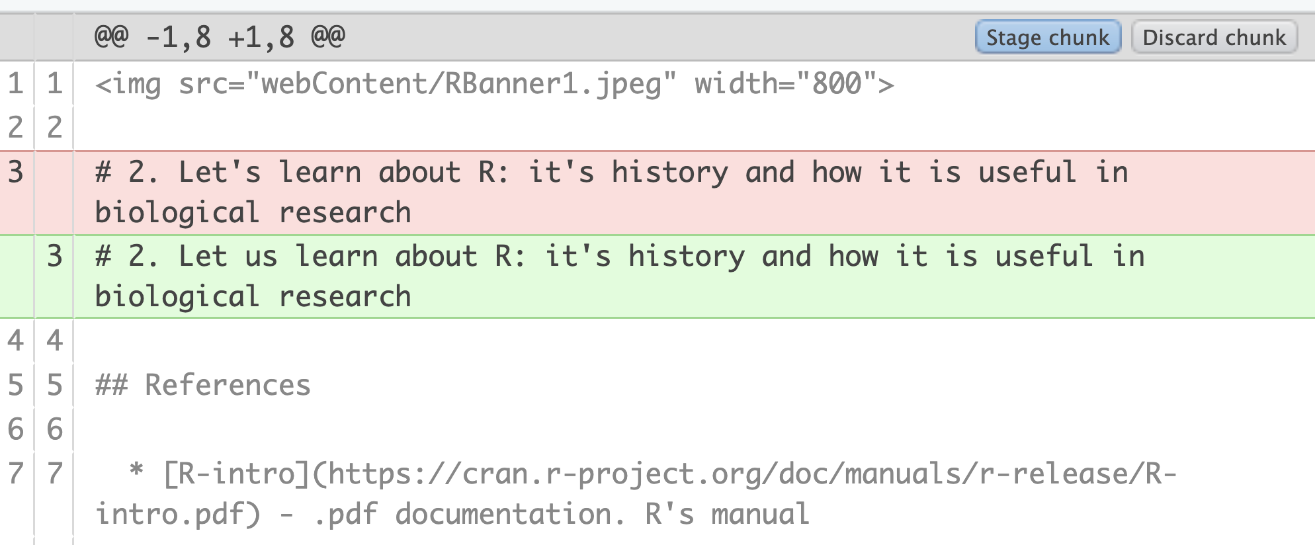
Using Git with RStudio (1)
Exercise: We will use RStudio’s “git” tab to track the changes we make to the repository
Find the right windows, tabs and files
Go to the File tab and navigate to modules/02_RStudio.
Click on 02_240129_R_Basics.Rmd to open it in the editor.
Click on the “git” tab in the upper right.
Make a change to the tracked file
Modify 02_240129_R_Basics.Rmd and save it. I changed “let’s” to “let us”.
Notice the “modified” status appear.
“Diff”
Select the file and click “diff” on the left side of the window.
See the difference between your working copy and the repository.

Slide 10
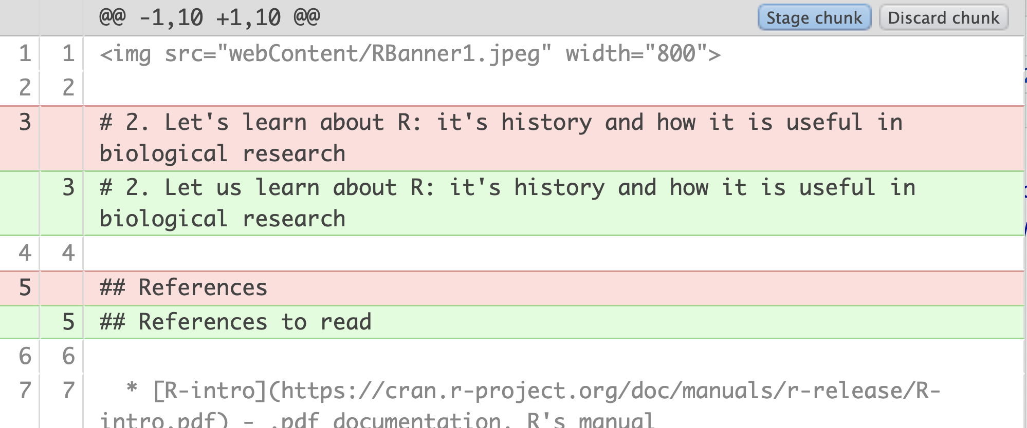
Using Git with RStudio (2)
We will use RStudio’s “git” tab to track the changes we make to the repository
Make another change and save it.
I changed “References” on line 5 to “References to read”
Now two lines are diff’d.

Slide 11
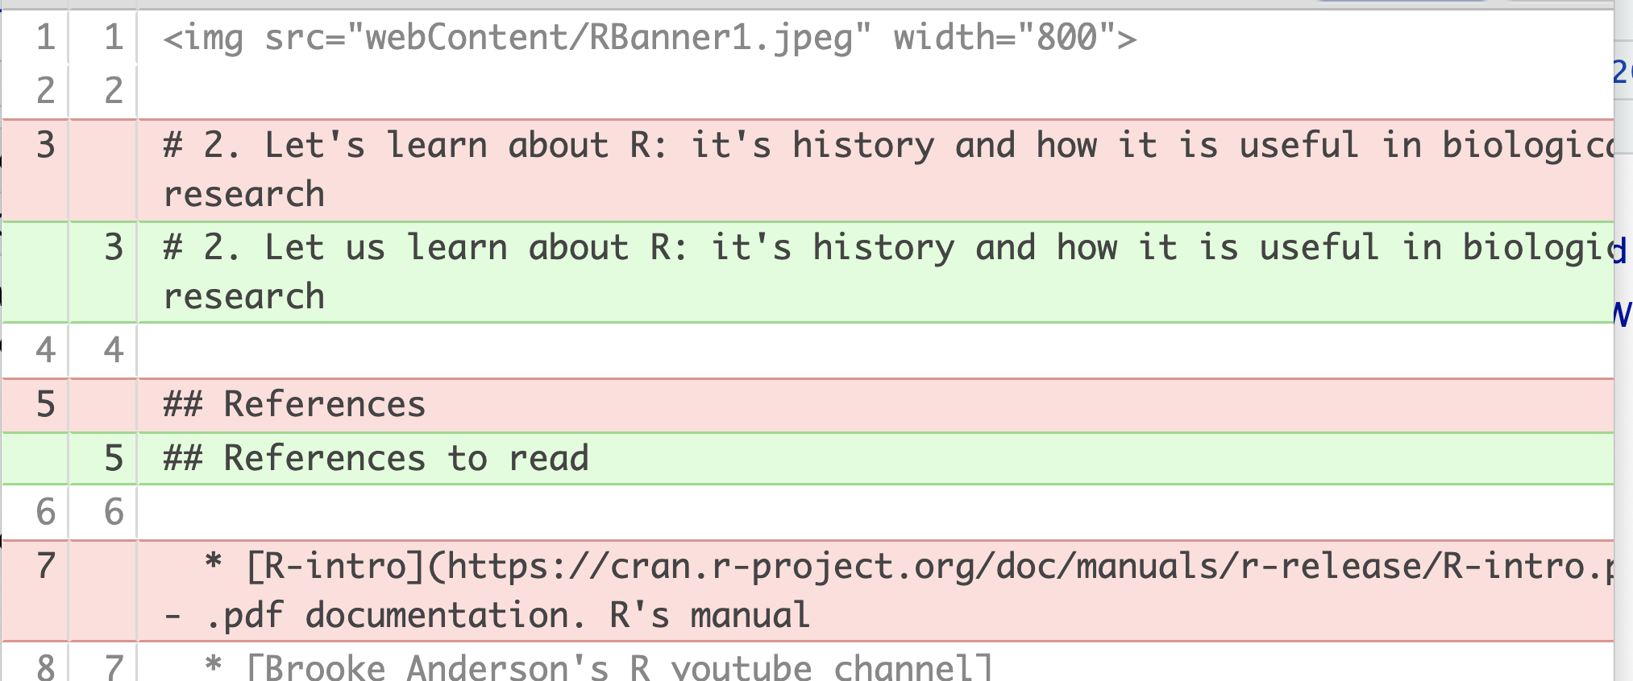
Git/RStudio (3)
We will use RStudio’s “git” tab to track the changes we make to the repository
I deleted the R-intro reference, line 7.
Now the line numbers are different
Repo – still contains line 7.
Working tree– line 7 is now the reference to Brooke’s youtube channel.

Slide 12
Git/RStudio (4) Reverting your changes, safely
You can revert to the repository’s version of a file
But it overwrites your changes
So, use with caution- make a copy first
Exercise
Make a copy of 02_240129_R_Basics.Rmd by checking the box next to the filename and go to the “gear” icon to copy it.
Then, in the Git tab, click box by the modified file, click the gear icon and choose “Revert”
Confirm in the dialog box.

Slide 13
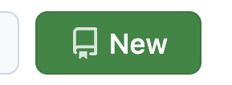
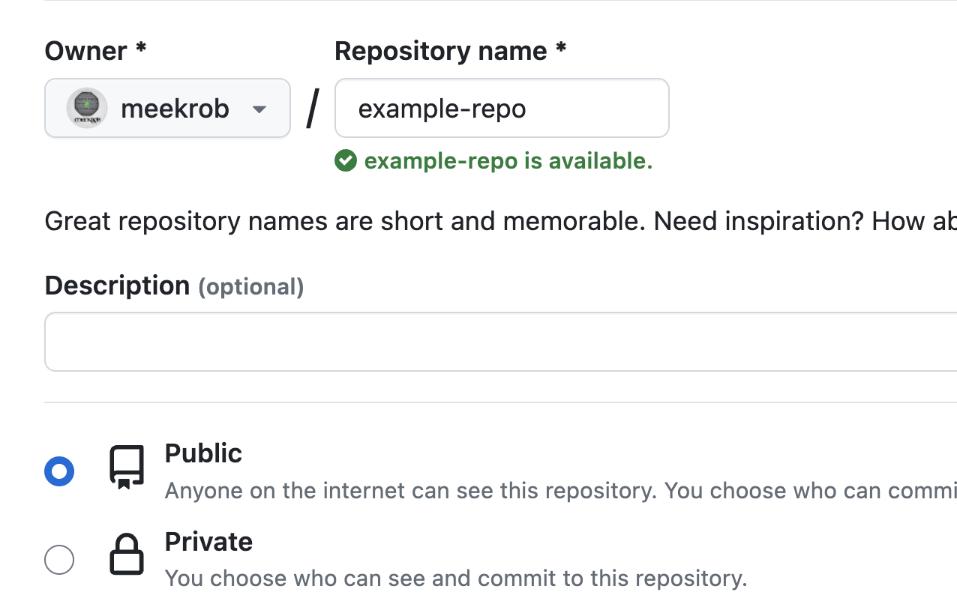
Creating/working on your own repository
Create a remote repository
Go to your github.com/accountname
Click on the Repositories tab and find the New button
Type ‘my-resources’

Slide 14
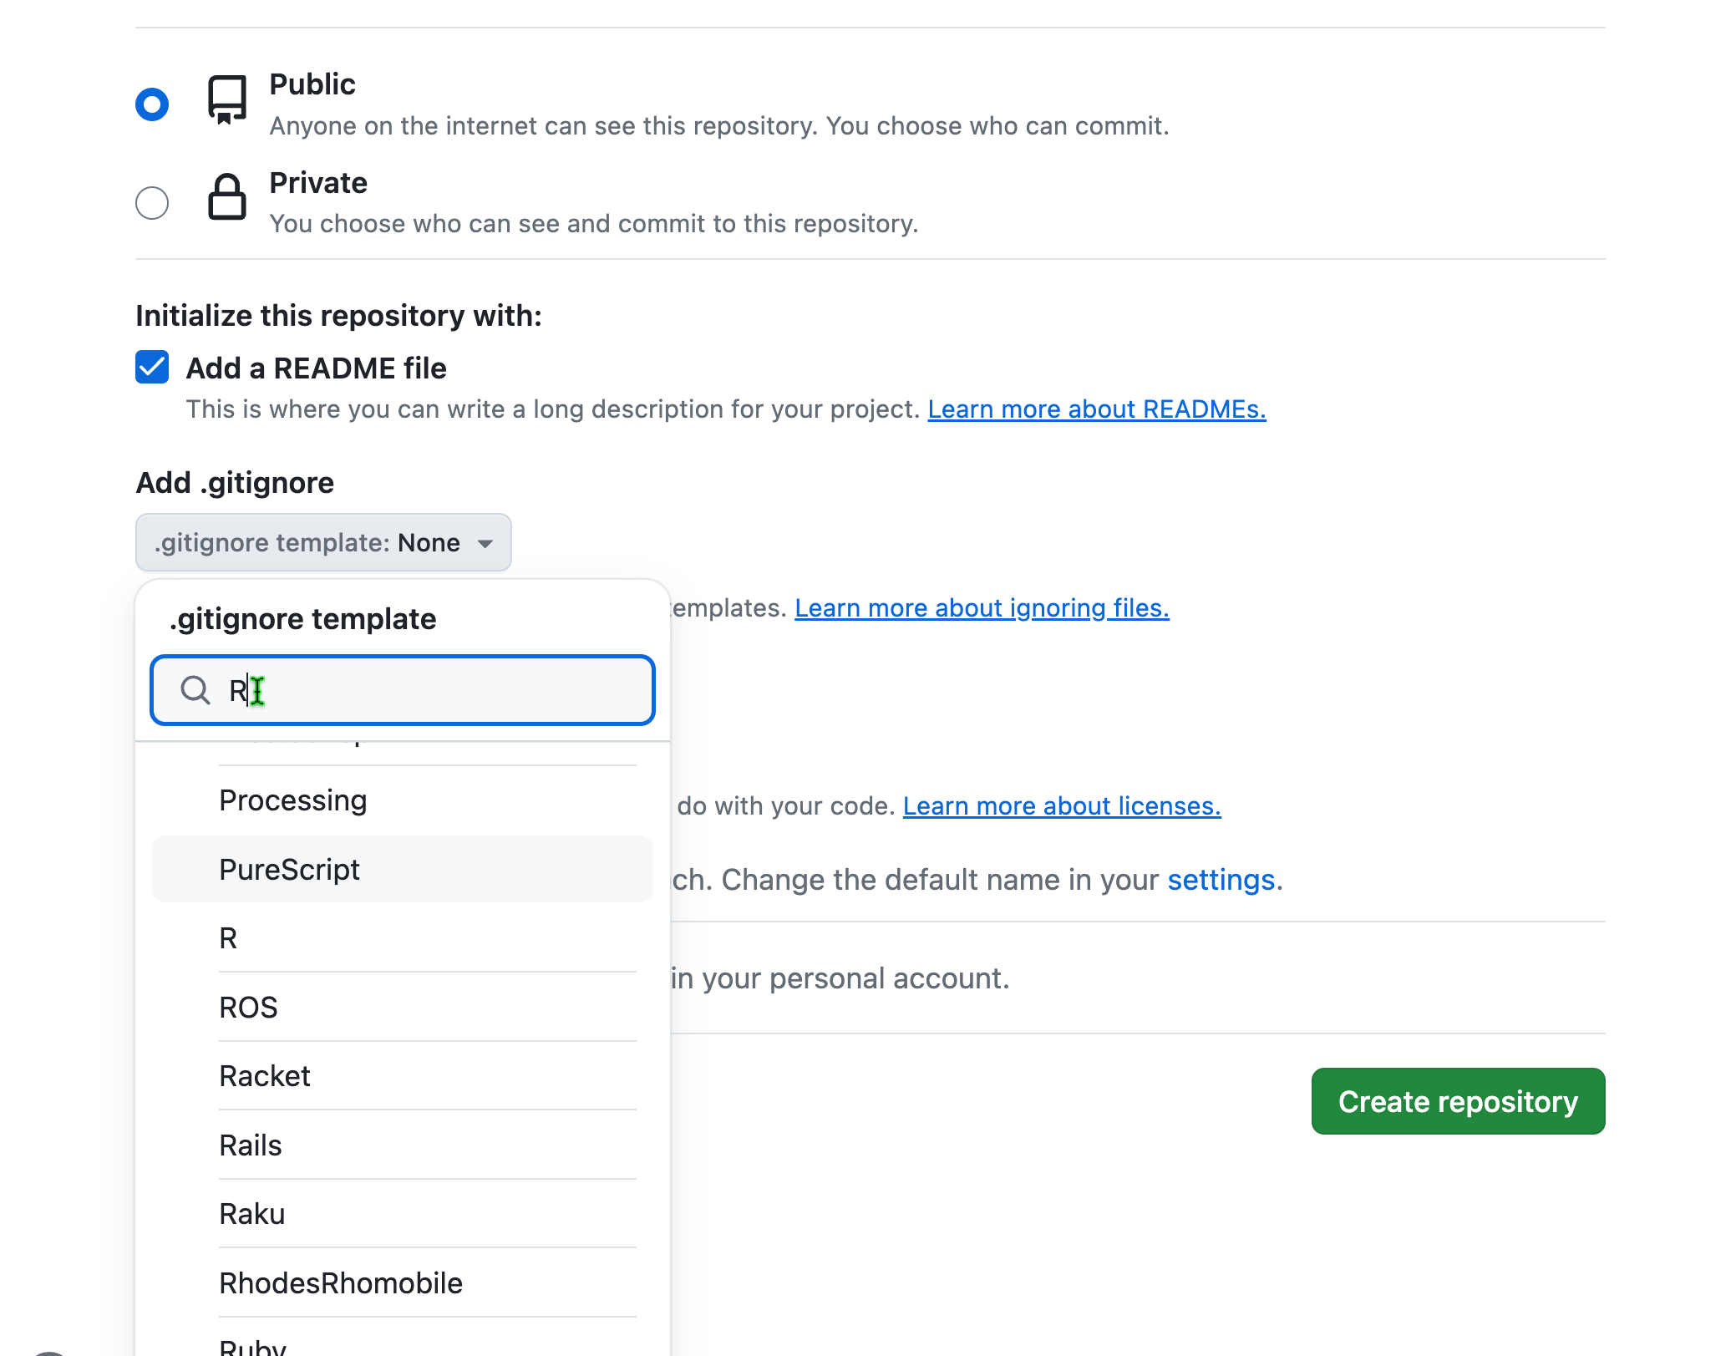
Create a new repo (continued)

Slide 15
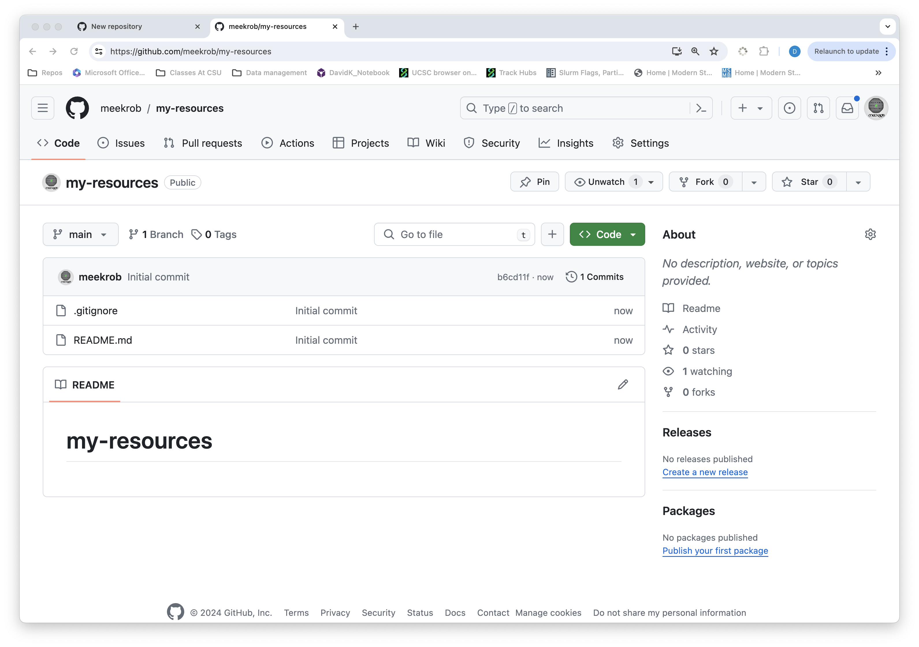

Slide 16
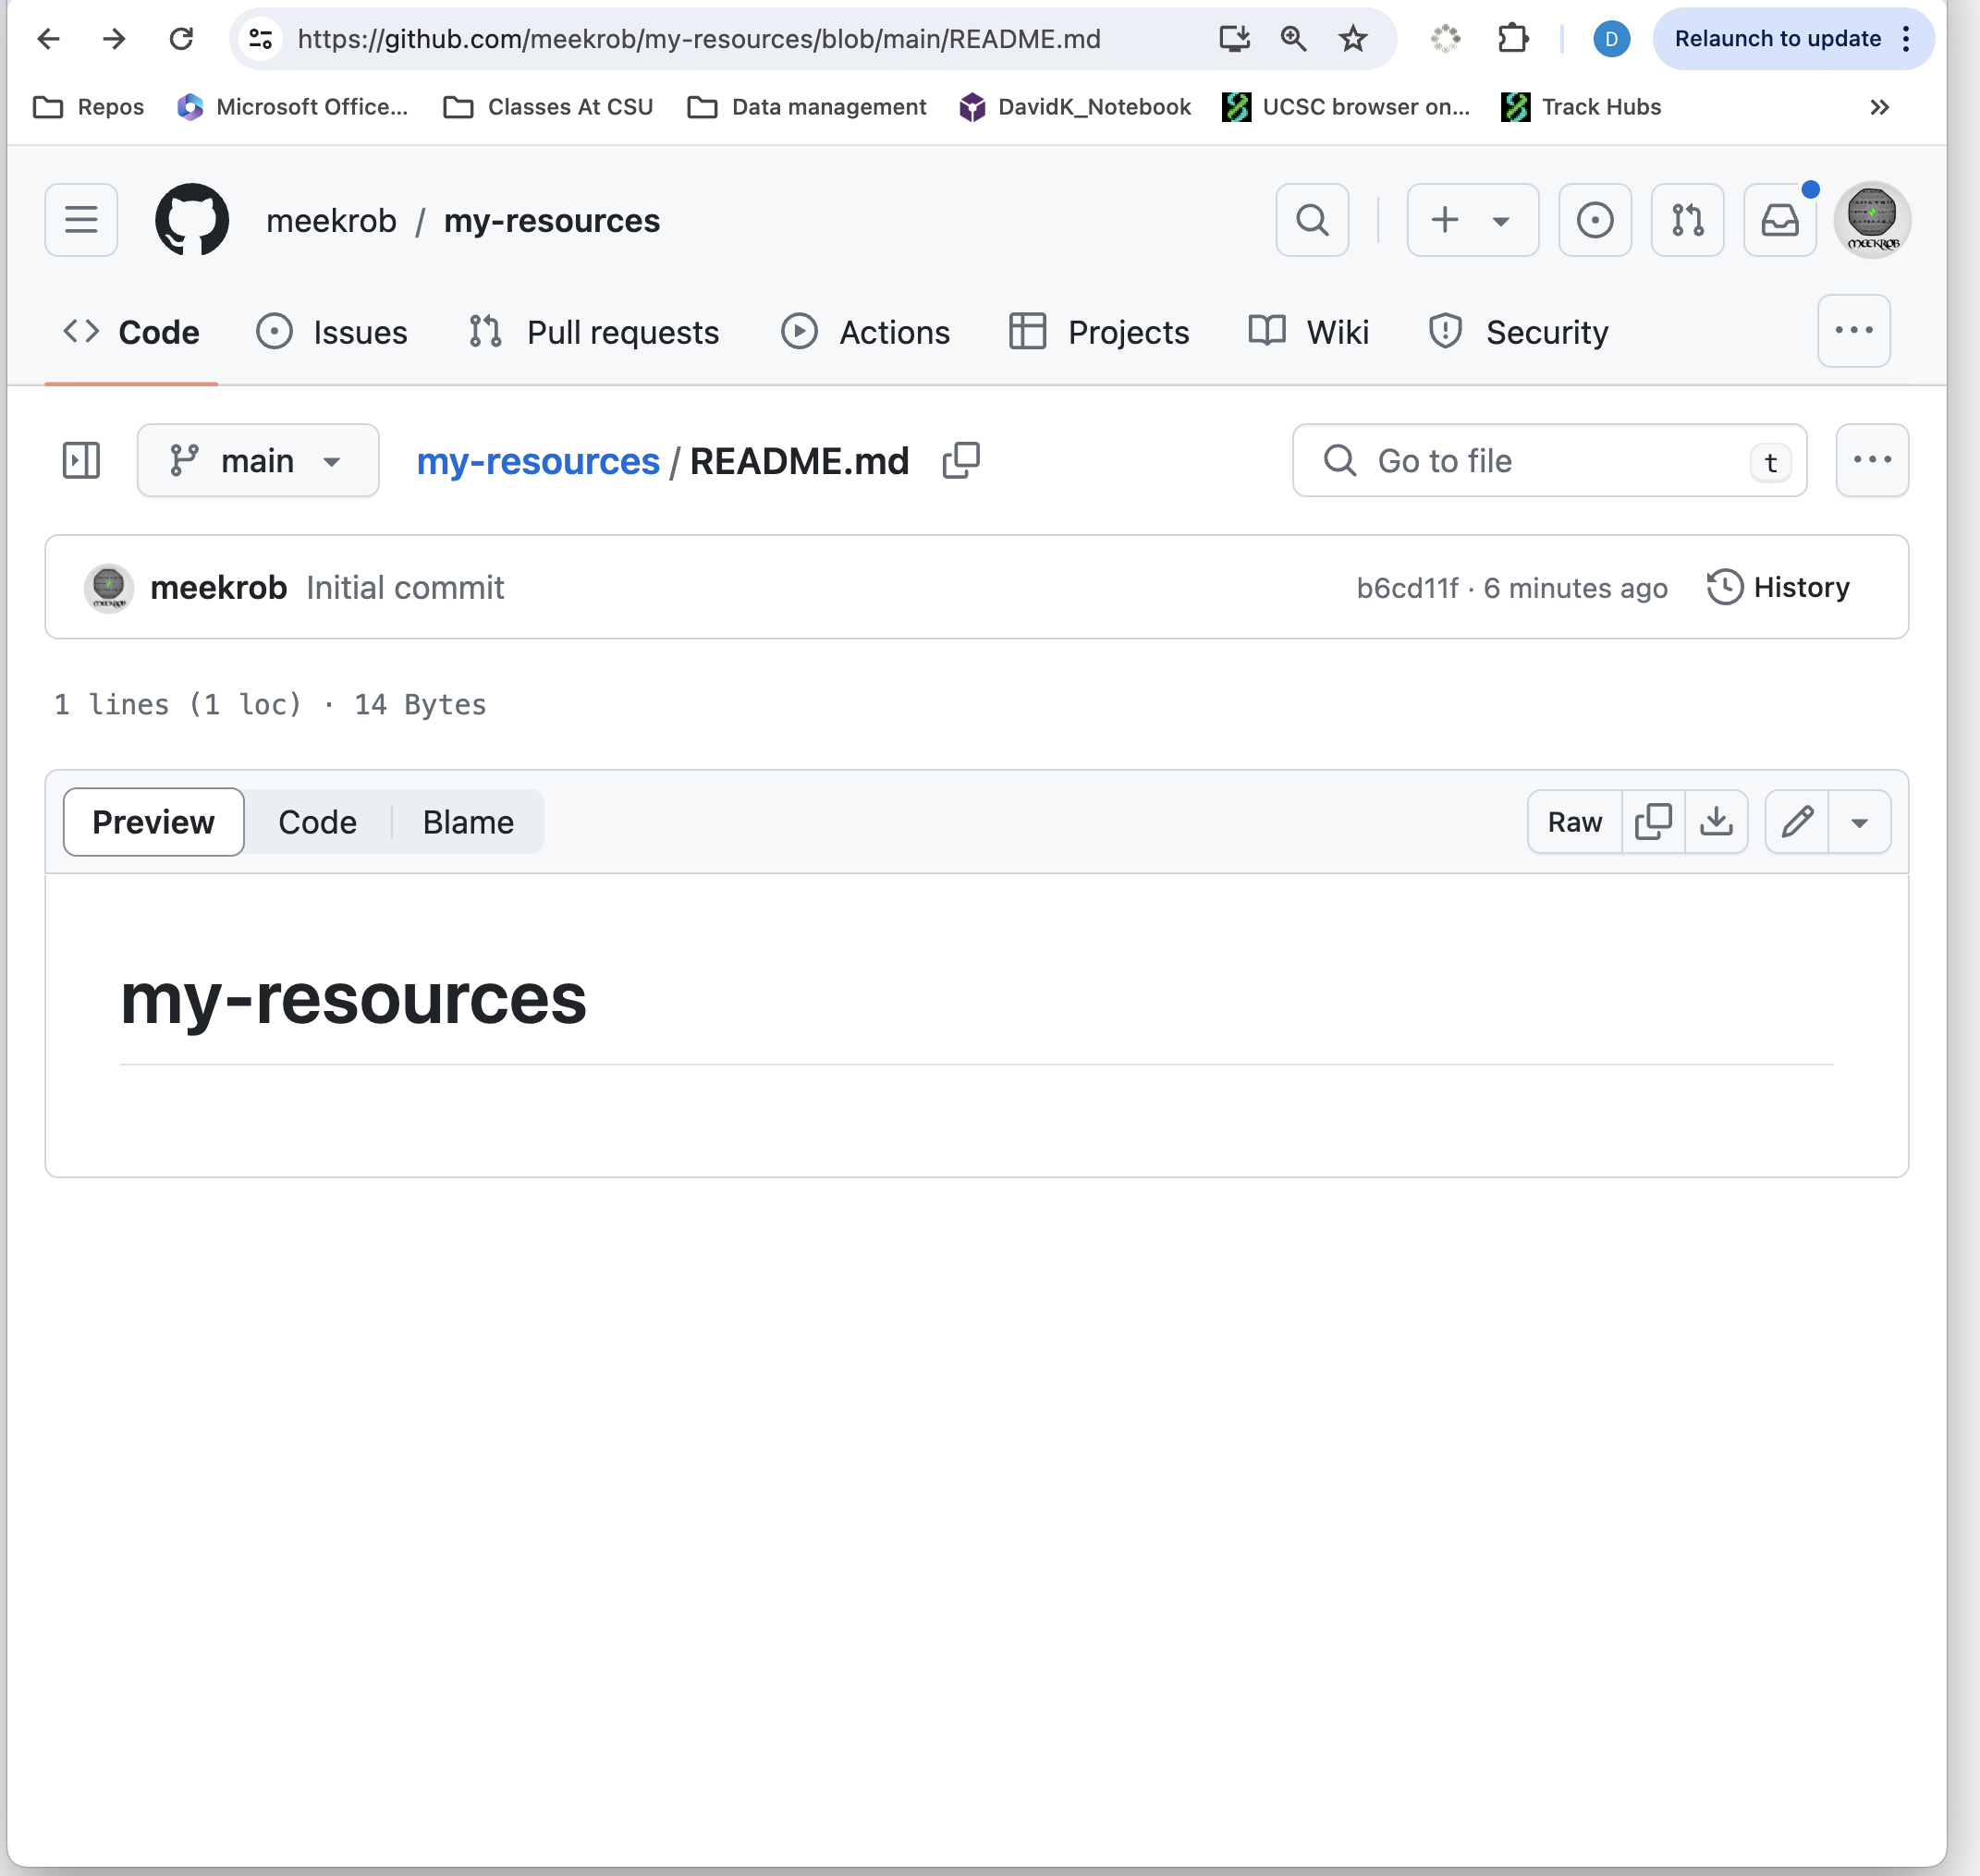
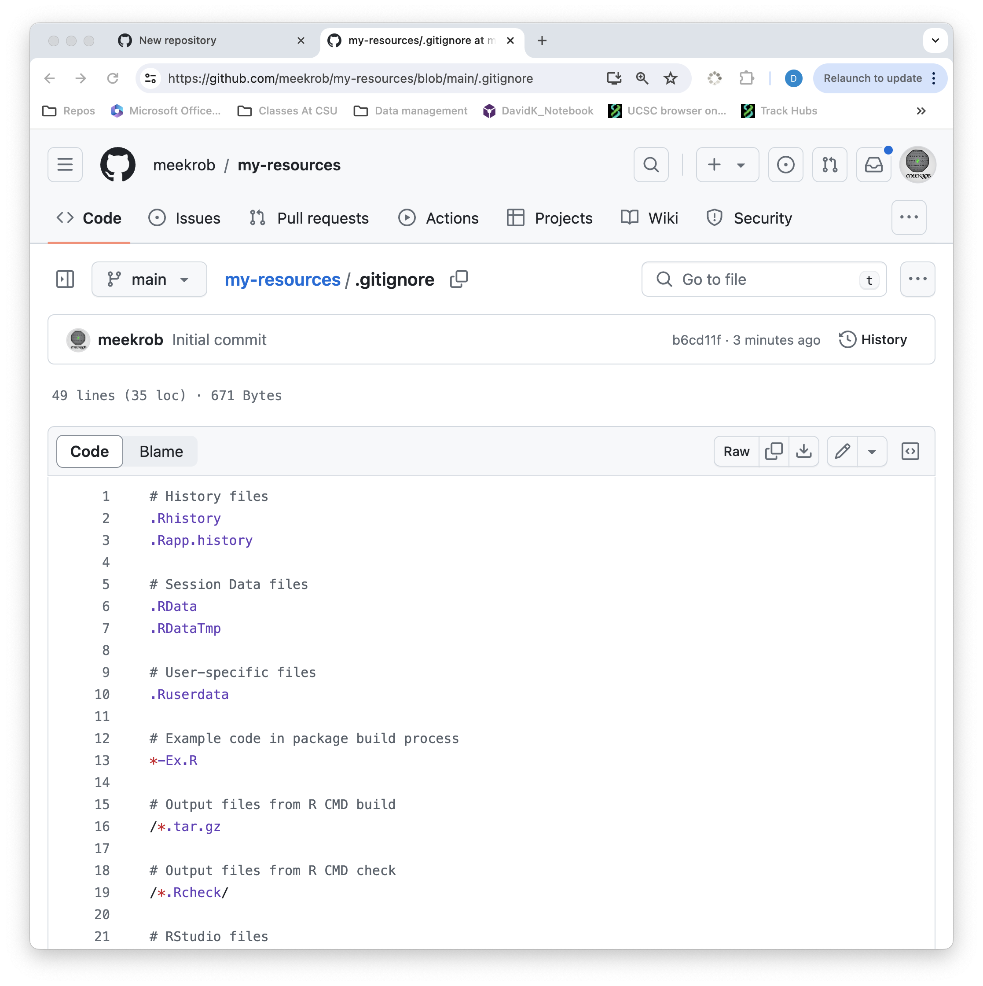

Slide 17
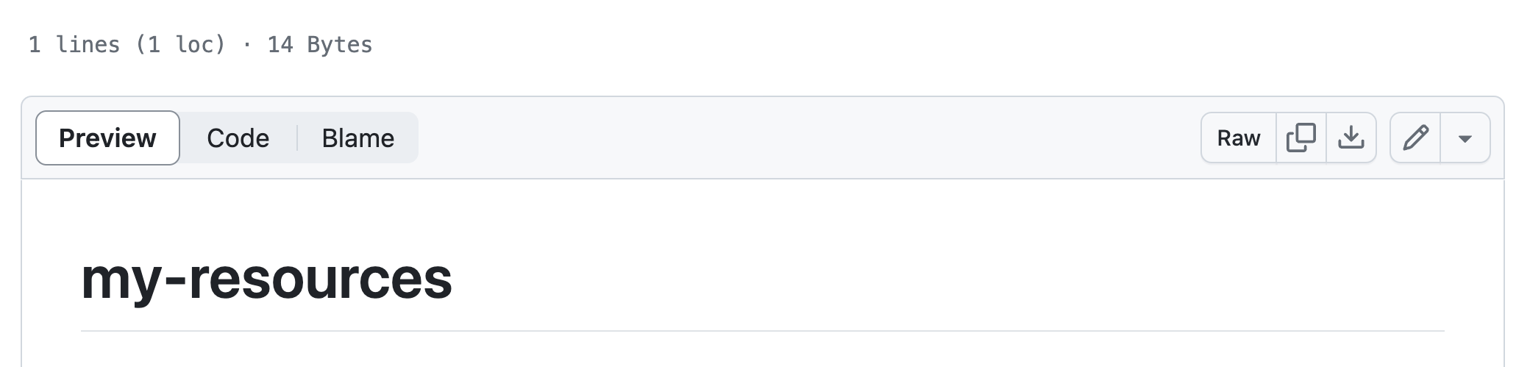
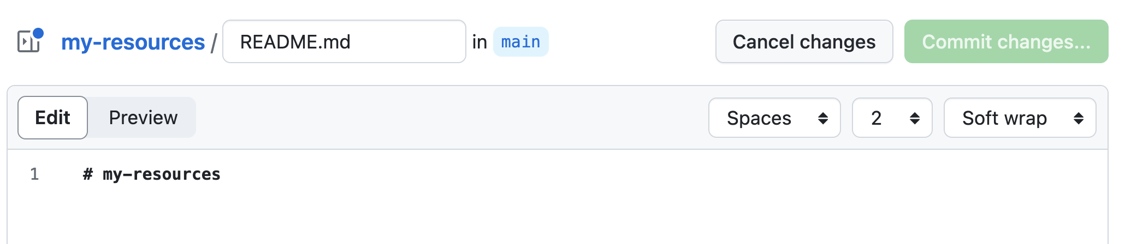

1) Click preview
2) Click to edit
3) Type in here (see next slide)

Slide 18
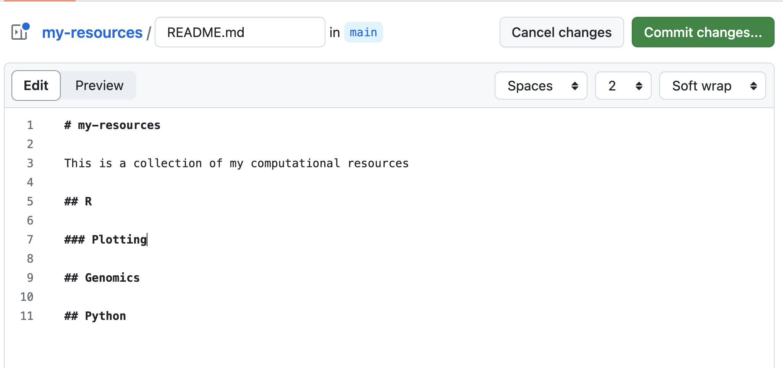
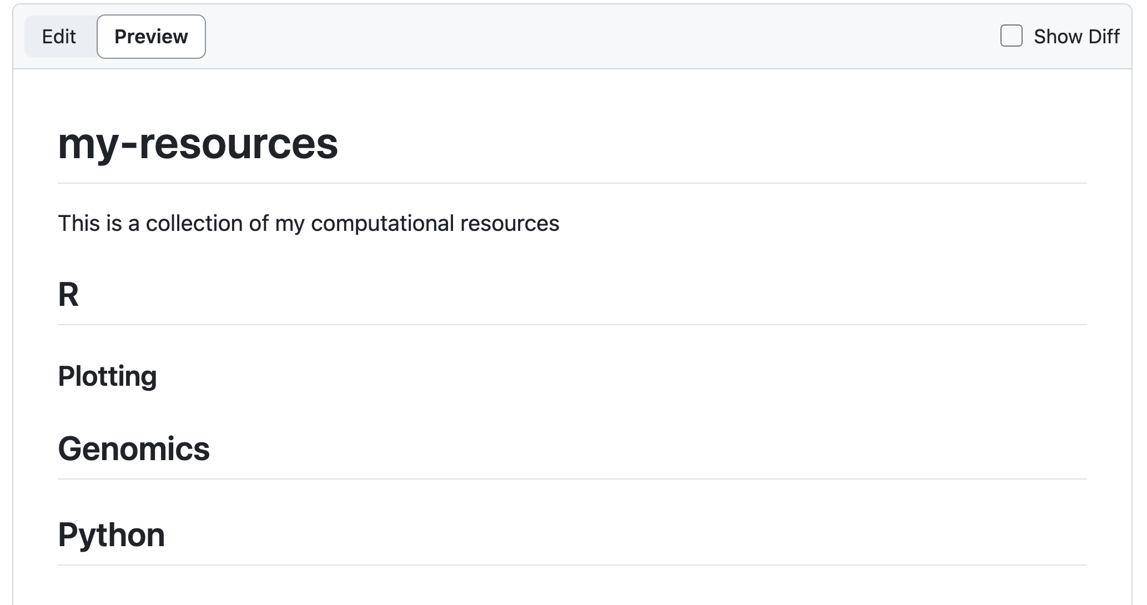

Slide 19
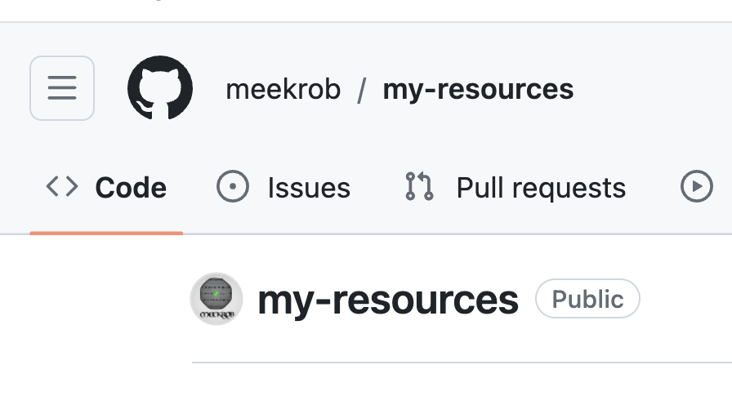
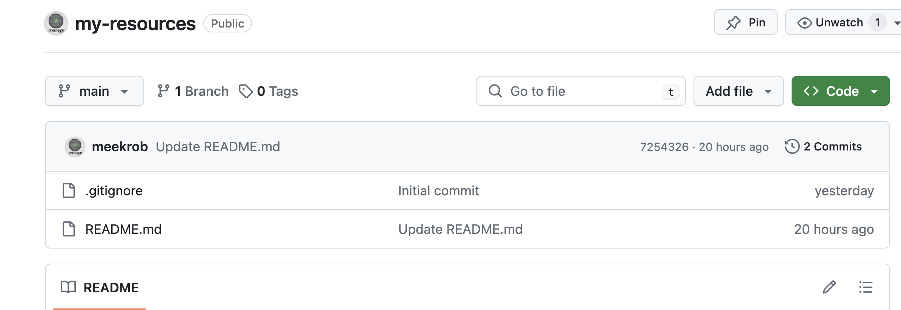
Notice “commits” and different info
For the two files

Slide 20
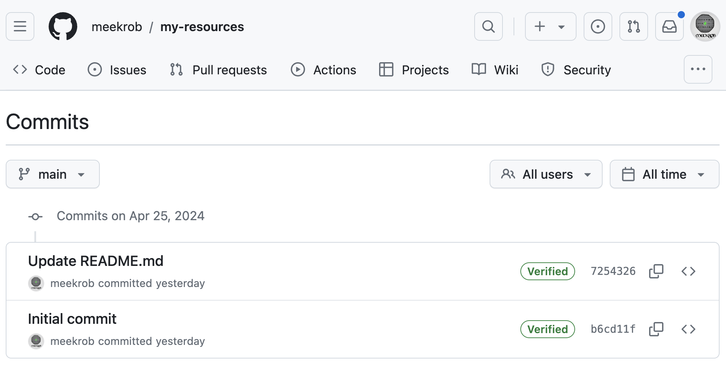
Examine your repo’s history
The commit message. Click to get commit details: the diff of each file change
for the commit.
First 6 digits of unique ID for the commit. Click to get the commit details.
Browse repository at this point
Copy full SHA
(for command line use)

Slide 21
Exercise – clicking on the commit page
Click the ID (view commit details) for the first commit (all the way at the bottom). This was the initial commit. What is displayed?
Click the commit message (also view commit details) for the second commit. We changed the README. What is displayed?
ANSWER Initial commit: All diffs show the addition of the files.
ANSWER Second commit shows the added lines of the README file.

Slide 22
Next steps: pull, edit, push
Clone your example repo using RStudio
Make changes, stage, commit, push.
More involved- Set up SSH keys to authenticate without typing your password each time

Slide 23
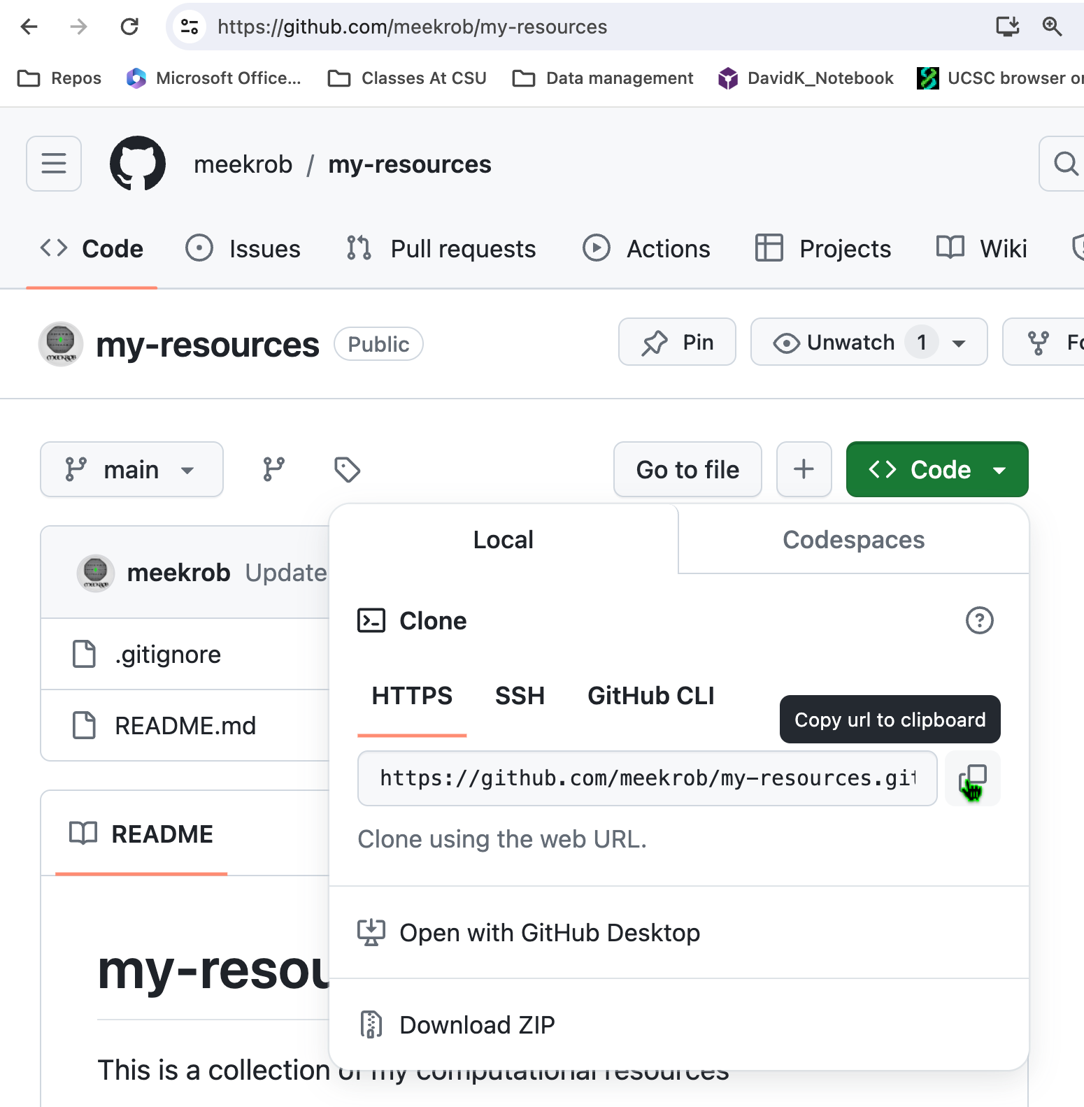
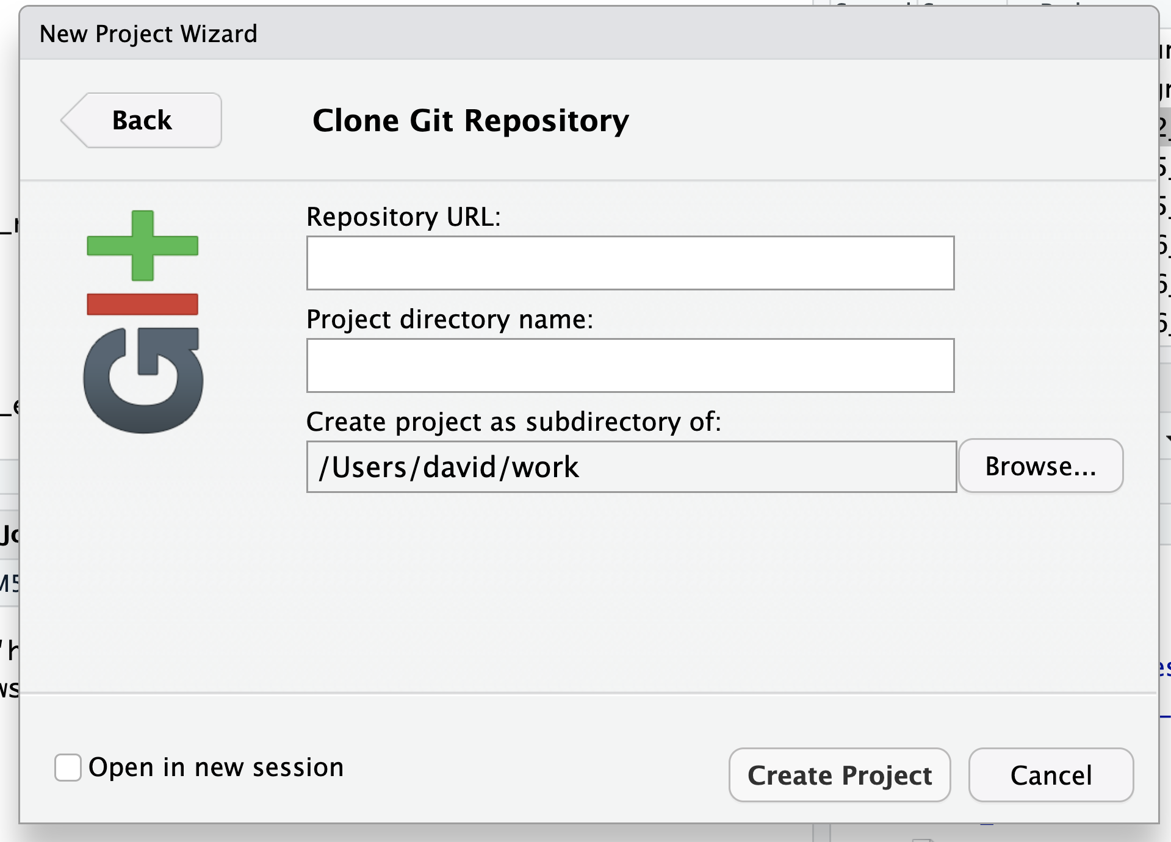
In RStudio
On github.com/yourusername/my-resources
New Project
Version Control
Git
Copied url
I left this blank

Slide 24
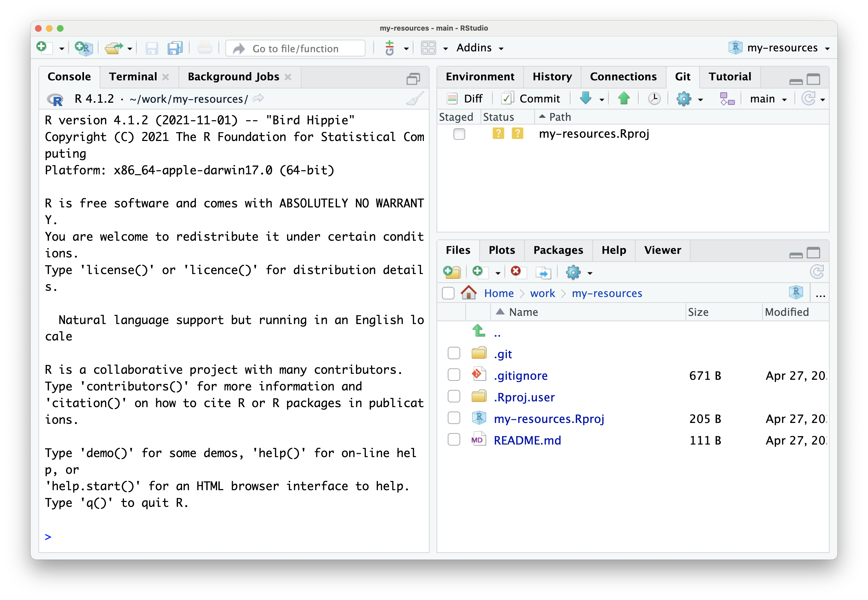

Slide 25
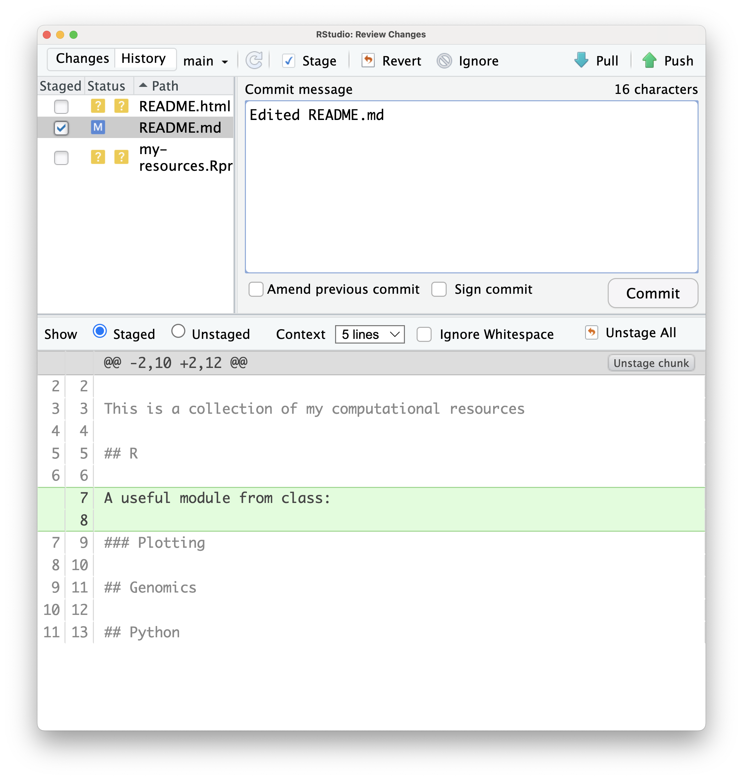
The commit message can’t be blank

Slide 26
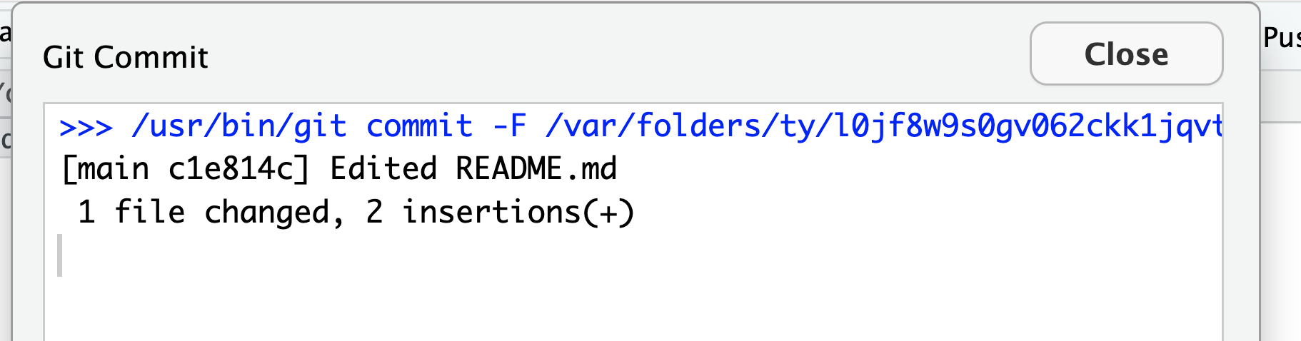
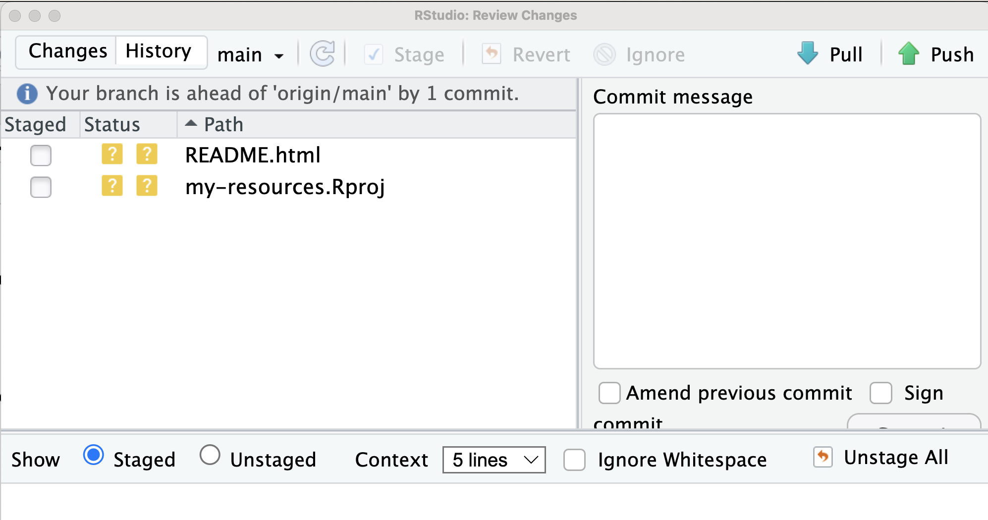
Click here

Slide 27
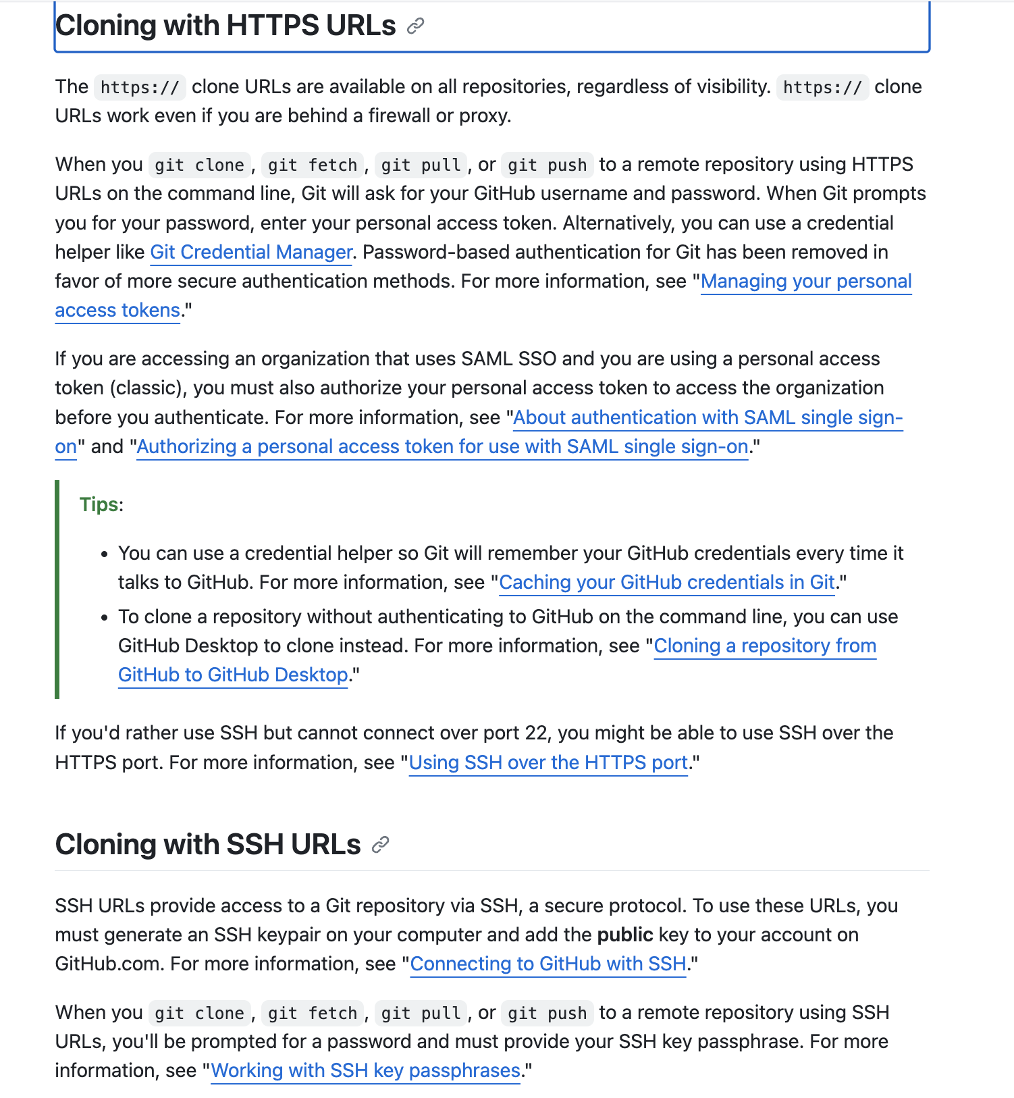
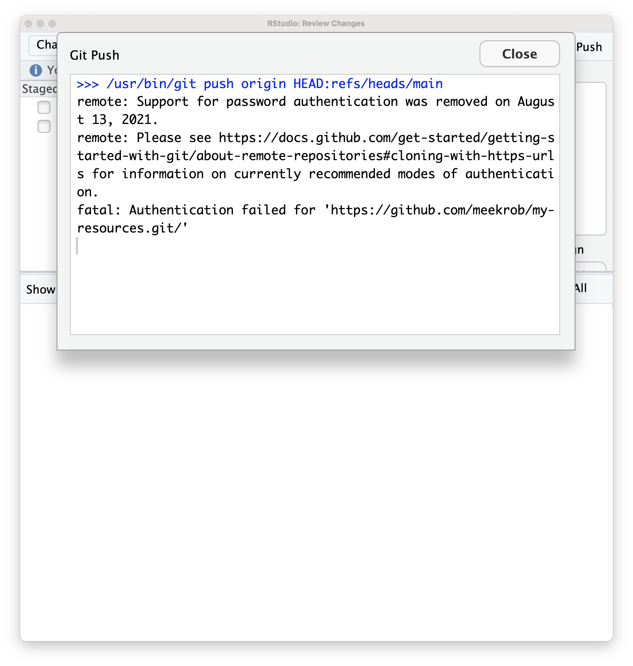
Error

Slide 28
Using SSH keys
What are they?
Generation
Add them on github. (Should work with all repos on your computer)
In RStudio
Change the remote to the ssh url (git@github.com:meekrob/my-resources.git)
See if you can push
Deal with other possible problems
Requirements:
Mac: Terminal (already installed). Go to Finder->Go->Utilities. Scroll down and double click on Terminal.
Windows:
Powershell (already installed)
Starting windows powershell (in user and admin mode)
git-bash (need to install from https://gitforwindows.org/)

Slide 29




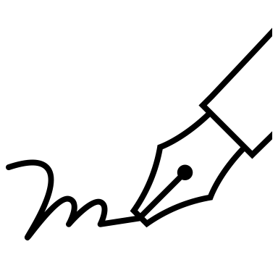

SSH keys for password-less login
ssh-keygen produces two large cryptographic strings
Private key
They are numbers. The public key is computed from the private key.
The private key cannot be mathematically derived from the public key
Public key
Private key
Public key
User
”Sign” data with private key
Validate data “signature” with public key
Server
Can send in the open
data
data
*Log in securely, then provide server with your public key if you want to authenticate this way.
You: generate private, public key pair. These are long cryptographic strings.
You: don’t share private key ever
You: give public key to the server, associated with your account
Server: Uses public key to verify that your credentials were signed with your private key

Slide 30
Check for existing keys
Exercise for rest of class. Work in groups of your own OS
On the links below, make sure you click the tab for your OS.
https://docs.github.com/en/authentication/connecting-to-github-with-ssh/checking-for-existing-ssh-keys
Generate new keys
https://docs.github.com/en/authentication/connecting-to-github-with-ssh/generating-a-new-ssh-key-and-adding-it-to-the-ssh-agent
Adding the new key to your account
https://docs.github.com/en/authentication/connecting-to-github-with-ssh/adding-a-new-ssh-key-to-your-github-account
Testing the connection
https://docs.github.com/en/authentication/connecting-to-github-with-ssh/testing-your-ssh-connection
Go back to RStudio
In RStudio Terminal tab, do:
git remote set-url origin git@github.com:meekrob/my-resources.git
Now click the up-arrow to push!!!

Slide 31
Day 2
Adding Collaborators
Partner up. Add one another to your repo as a collaborator
Have a resource or template hat you are going to share with your partner
Branching and Pull requests
You are a newly added collaborator on your partner’s repo
You will:
Clone their repo
Make a new branch
Add a resource to a repo in that branch
Make a pull request
They will do the same on yours
You must merge the pull request
Forking
Fork the class repo
Add your_favorite_plot.png
Do a pull request
Github Pages and making a Portfolios

Slide 32
Homework and final project
Add to your resources repo
Templates
Links to modules
Make a fork of the class repo
Make an assignments folder and add your work
Make a github.io portfolio for your github account (using github pages)

Slide 33
Using an App with Git
Github desktop
SourceTree (Atlassian)– shows graph of branches
Other IDEs, such as VS Code, RStudio, etc., that highlight status of files in repo and commit/push/pull

